Slide 1
100-150 IBD individuals from the IBD outpatient service will complete intake questions via the android application (10 mins) while waiting to see their gastroenterologist. Participants must complete every question, and if any questions are left unanswered, the program will identify the questions which remain unanswered in order to prompt completion.
The program will then calculate a score using the Depression Anxiety Stress Scale (DASS). Based on DASS scores, the highest anxiety or depression score will determine website feedback e.g., “Very low, low, Moderate, Severe distress.
After the visual feedback participants will be asked a further series of questions, following which ALL participants response will have been recorded.
All participants’ data will be stored on the SD or USB card where the program was initated. Data will be stored in sequential tabular form that can be imported into excel. Each participant’s dataset will be added to the larger dataset sequentially. Date and time of data collection for each participant will also be recorded.

Slide 2
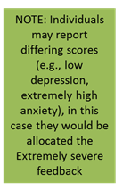

DASS Depression Score <4
DASS Depression Score = 5-10
DASS Depression Score = 11-13
DASS Depression Score 14+
Follow the pathway of the highest DASS score attained
DASS Anxiety Score < 3
DASS Anxiety Score 4-7
DASS Anxiety Score 8-9
DASS Anxiety Score 10+
Individuals tend to report minimal levels of psychological distress
Individuals tend to report some symptoms which may be associated with psychological distress
Individuals tend to report symptoms more often than not may be associated with psychological distress
Individuals tend to report symptoms strongly and frequently which may be associated with psychological distress
For further information and strategies to manage psychological distress related to IBD please go to IBDclinic.org.au
We recommend you meet with your mental health professional, or if symptoms worsen, contact your GP.
For further information and strategies to manage psychological distress related to IBD please go to IBDclinic.org.au
We recommend you contact your doctor or psychologist within 24 hours and arrange a mental health review. Please also feel free to contact your local hospital IBD nurse or
Lifeline.org.au
We recommend you contact your doctor or psychologist immediately to arrange a mental health review. Please also feel free to contact your local hospital IBD nurse or Lifeline.org.au

Slide 3
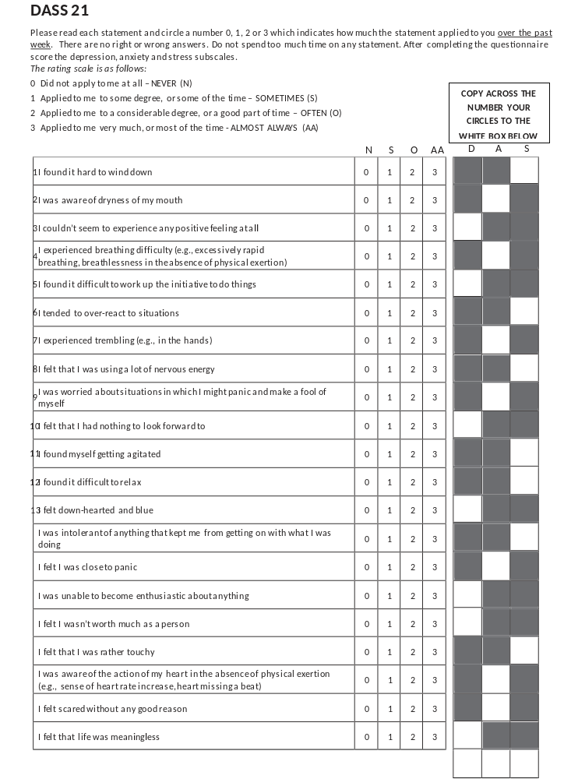
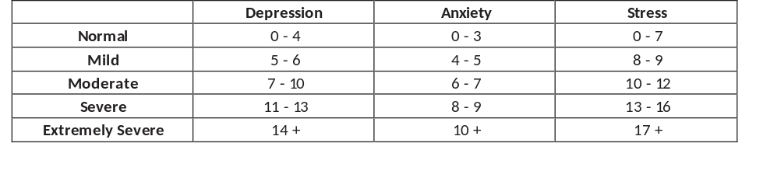
The DEPRESSION ANXIETY AND STRESS SCALE (DASS), SCORING PROCEDURE, AND SCORE INTERPRETATION
For more information, see: http://www.blackdoginstitute.org.au/docs/3.dass21withscoringinfo.pdf
CREATE TOTALS BY SUMING ALL THE NUMBER IN EACH COLUMN - TOTALS

Slide 4
Outpatient Brief
Mental Health Review
Mental health concerns are a common issue in patients living with Inflammatory Bowel Disease. This program will ask you about your mental health symptoms and provide feedback about various options that may be of benefit.
Total time to complete this assessment will be 10 minutes.
If you have any concerns, please talk to your
IBD nurse or Gastroenterologist.

Slide 5

Patient questionnaire - please answer the following questions:
1. Age? Dropbox range: 16-100
2. Gender? Dropbox options: ☐ Male ☐ Female
3. Condition: Dropbox options: ☐ Crohn’s disease ☐Ulcerative colitis ☐Other
4. Number of years diagnosed with IBD? Dropbox range: 1-100
5. In the past 3 months my IBD has been: Dropbox options:
☐ Constantly active, giving me symptoms every day
☐ Often active, giving me symptoms most days
☐ Sometimes active, giving me symptoms on some days (for instance 1 – 2 days / week)
☐ Occasionally active, giving me symptoms 1 – 2 days / month
☐ Rarely active, giving me symptoms on a few days in the past 6 months
☐ I was well in the past 3 months, what I consider a remission or absence of symptoms.
Next

Slide 6
Patient questionnaire - please answer the following questions:
Does not need to be in a table, dropbox options may be easier?
 | Very poor | Poor | Neither poor nor good | Good | Very good
6. How would you rate your quality of life? | ☐ | ☐ | ☐ | ☐ | ☐
7. How would you rate your level of social support? | ☐ | ☐ | ☐ | ☐ | ☐
8. Please rate your overall level of self-confidence when it comes to managing your own PHYSICAL health? | ☐ | ☐ | ☐ | ☐ | ☐
9. Please rate your overall level of self-confidence when it comes to managing your own MENTAL health? | ☐ | ☐ | ☐ | ☐ | ☐
10. How would you rate your quality of sleep? | ☐ | ☐ | ☐ | ☐ | ☐
11. Average number of hours sleep in the last 24 hours? | Dropbox response options: 1 hour, 2 hour, 3 hour,……..10+ hours)
Next

Slide 7
Patient questionnaire - please answer the following questions:
(DASS 7-items assessing STRESS below) Does not need to be in a table, dropbox options may be easier?
 | Did not apply to me at all | Applied to me to some degree, or some of the time | Applied to me to a considerable degree, or a good part of time | Applied to me very much, or most of the time
12. I found it hard to wind down | ☐ | ☐ | ☐ | ☐
13. I tended to over-react to situations | ☐ | ☐ | ☐ | ☐
14. I felt that I was using a lot of nervous energy | ☐ | ☐ | ☐ | ☐
15. I found myself getting agitated | ☐ | ☐ | ☐ | ☐
16. I found it difficult to relax | ☐ | ☐ | ☐ | ☐
17. I was intolerant of anything that kept me from getting on with what I was doing | ☐ | ☐ | ☐ | ☐
18. I felt that I was rather touchy | ☐ | ☐ | ☐ | ☐
Note regarding STRESS scoring:
“Did not apply to me at all” = 0; “Applied to me to some degree, or some of the time” = 1; “Applied to me to a considerable degree, or a good part of time” = 2; “Applied to me very much, or most of the time” = 3
MIN score: 0; Maximum score 21
Ranges: Normal (0-7), Mild (8-9), Moderate (10-12), Severe (13-16), Extremely severe (17-21)
Next

Slide 8
Patient questionnaire - please answer the following questions:
(DASS 7-items assessing ANXIETY below) Does not need to be in a table, dropbox options may be easier?
 | Did not apply to me at all | Applied to me to some degree, or some of the time | Applied to me to a considerable degree, or a good part of time | Applied to me very much, or most of the time
19. I was aware of dryness of my mouth | ☐ | ☐ | ☐ | ☐
20. I experienced breathing difficulty (e.g., excessively rapid breathing, breathlessness in the absence of physical exertion) | ☐ | ☐ | ☐ | ☐
21. I experienced trembling (e.g., in the hands) | ☐ | ☐ | ☐ | ☐
22. I was worried about situations in which I might panic and make a fool of myself | ☐ | ☐ | ☐ | ☐
23. I felt I was close to panic | ☐ | ☐ | ☐ | ☐
24. I was aware of the action of my heart in the absence of physical exertion (e.g., sense of heart rate increase, heart missing a beat) | ☐ | ☐ | ☐ | ☐
25. I felt scared without any good reason | ☐ | ☐ | ☐ | ☐
Note regarding ANXIETY scoring:
“Did not apply to me at all” = 0; “Applied to me to some degree, or some of the time” = 1; “Applied to me to a considerable degree, or a good part of time” = 2; “Applied to me very much, or most of the time” = 3
MIN score: 0; Maximum score 21
Ranges: Normal (0-3), Mild (4-5), Moderate (6-7), Severe (8-9), Extremely severe (10-21)
Next

Slide 9
Patient questionnaire - please answer the following questions:
(DASS 7-items assessing DEPRESSION below) Does not need to be in a table, dropbox options may be easier?
 | Did not apply to me at all | Applied to me to some degree, or some of the time | Applied to me to a considerable degree, or a good part of time | Applied to me very much, or most of the time
26. I couldn't seem to experience any positive feeling at all | ☐ | ☐ | ☐ | ☐
27. I found it difficult to work up the initiative to do things | ☐ | ☐ | ☐ | ☐
28. I felt that I had nothing to look forward to | ☐ | ☐ | ☐ | ☐
29. I felt down-hearted and blue | ☐ | ☐ | ☐ | ☐
30. I was unable to become enthusiastic about anything | ☐ | ☐ | ☐ | ☐
31. I felt I wasn't worth much as a person | ☐ | ☐ | ☐ | ☐
32. I felt that life was meaningless | ☐ | ☐ | ☐ | ☐
Note regarding DEPRESSION scoring:
“Did not apply to me at all” = 0; “Applied to me to some degree, or some of the time” = 1; “Applied to me to a considerable degree, or a good part of time” = 2; “Applied to me very much, or most of the time” = 3
MIN score: 0; Maximum score 21
Ranges: Normal (0-4), Mild (5-6), Moderate (7-10), Severe (11-13), Extremely severe (14-21)
Next

Slide 10
Patient questionnaire - please answer the following questions:
(does not need to be in a table, dropbox options may be easier?)
 | YES | NO
33. Do you consider hurting yourself, others, or feel suicidal? | ☐ | ☐
34. Are you currently are CURRENTLY seeing a mental health professional? | ☐ | ☐
35. Do you have an appointment with a mental health expert within the next 14 days or willing to contact your local doctor (GP) if your mental health symptoms worsen? | ☐ | ☐
 | None | Mild | Moderate | Severe | Extreme
36. Please select the option that best describes your PAIN LEVELS on average over the last 24 hours? | ☐ | ☐ | ☐ | ☐ | ☐
37. Please select the option that best describes your FATIGUE LEVELS on average over the last 24 hours? | ☐ | ☐ | ☐ | ☐ | ☐
Next

Slide 11

At this point, the program will score the 21 items into three scores for each of: anxiety; depression, and stress. Whichever of the anxiety or depression scores is highest will determine which of the 4 feedback visual responses that participants will receive. After the feedback, patients will then be asked several follow-up questions.
Saving DASS score (will not be displayed)

Slide 12
Please note:
Mental health concerns are a common issue in patients living with Inflammatory Bowel Disease. Based on your responses, the program has calculated your levels of anxiety, depression and stress.
Please be aware that these results are only subjective. A comprehensive assessment by a trained mental health specialist is needed to confirm any diagnosis or symptom severity.
If you have any concerns or questions, please talk to your IBD nurse, gastroenterologist, medical practitioner or mental health professional (e.g., psychiatrist, psychologist).

Slide 13

Individuals tend to report minimal levels of psychological distress
For further information and strategies to manage psychological distress related to IBD please go to:
If you have any questions or concerns please talk to your Gastroenterologist or IBD nurse
Next

Slide 14
Individuals tend to report some symptoms which may be associated with psychological distress
We recommend you meet with your mental health professional, or if symptoms worsen, contact your GP. For further information and strategies to manage psychological distress related to IBD please go to IBDclinic.org.au
If you have any questions or concerns please talk to your Gastroenterologist or IBD nurse
Next

Slide 15


Individuals tend to report symptoms which more often than not that may be associated with psychological distress
We recommend you contact your doctor or psychologist within 24 hours and arrange a mental health review. Please also feel free to contact your local hospital IBD nurse or Lifeline.org.au
Are you considering harming yourself or thinking about suicide?
Please talk about these thoughts/feelings with your Gastroenterologist/IBD nurse
Lifeline.org.au
Please review these results with your Gastroenterologist or IBD nurse
Next

Slide 16
Individuals tend to report symptoms strongly and frequently which may be associated with psychological distress
We recommend you contact your doctor or psychologist immediately to arrange a mental health review. Please also feel free to contact your local hospital IBD nurse or Lifeline.org.au
Are you considering harming yourself or thinking about suicide?
Please talk about these thoughts/feelings with your Gastroenterologist/IBD nurse
Lifeline.org.au
Please review these results with your Gastroenterologist or IBD nurse
Next

Slide 17
Post-feedback questions:
1. How helpful was this advice?
1 | 2 | 3 | 4 | 5 | 6 | 7 | 8 | 9 | 10
Not at all helpful ☐ | ☐ | ☐ | ☐ | ☐ | ☐ | ☐ | ☐ | ☐ | Extremely helpful ☐
2. How likely are you to follow-up on the advice that was provided?
1 | 2 | 3 | 4 | 5 | 6 | 7 | 8 | 9 | 10
Not at all likely ☐ | ☐ | ☐ | ☐ | ☐ | ☐ | ☐ | ☐ | ☐ | Extremely likely ☐
Next

Slide 18
Post-feedback questions:
3. Did you experience any distress after receiving feedback about your results?
1 | 2 | 3 | 4 | 5 | 6 | 7 | 8 | 9 | 10
None at all ☐ | ☐ | ☐ | ☐ | ☐ | ☐ | ☐ | ☐ | ☐ | Extreme distress ☐
4. Are the results provided consistent with your sense of current mental health status?
1 | 2 | 3 | 4 | 5 | 6 | 7 | 8 | 9 | 10
Not at all ☐ | ☐ | ☐ | ☐ | ☐ | ☐ | ☐ | ☐ | ☐ | Very much so ☐
Next

Slide 19
We are looking to develop an online support tool that patients can use on a fortnightly basis to report and manage their IBD symptoms, medications, mental health and quality of life.
This online service would NOT replace your current visits to the outpatient IBD clinic, but allow us to work with you more effectively to manage your IBD.
This online service would also allow you to communicate with your health professionals.
The following questions ask about your interest in using the online service.
Next

Slide 20
Post-feedback questions:
5. How helpful would an online out-patient service be to help monitor your IBD activity?
1 | 2 | 3 | 4 | 5 | 6 | 7 | 8 | 9 | 10
Not at all helpful ☐ | ☐ | ☐ | ☐ | ☐ | ☐ | ☐ | ☐ | ☐ | Extremely helpful ☐
6. How willing would you be to use an online out-patient service to help monitor your IBD activity?
1 | 2 | 3 | 4 | 5 | 6 | 7 | 8 | 9 | 10
Not at all willing ☐ | ☐ | ☐ | ☐ | ☐ | ☐ | ☐ | ☐ | ☐ | Extremely willing ☐
Next

Slide 21
Post-feedback questions:
7. How helpful would an online out-patient service be to help monitor your IBD-associated medications?
1 | 2 | 3 | 4 | 5 | 6 | 7 | 8 | 9 | 10
Not at all helpful ☐ | ☐ | ☐ | ☐ | ☐ | ☐ | ☐ | ☐ | ☐ | Extremely helpful ☐
8. How willing would you be to use an online out-patient service to help monitor your IBD-associated medications?
1 | 2 | 3 | 4 | 5 | 6 | 7 | 8 | 9 | 10
Not at all willing ☐ | ☐ | ☐ | ☐ | ☐ | ☐ | ☐ | ☐ | ☐ | Extremely willing ☐
Next

Slide 22
Post-feedback questions:
9. How helpful would an online out-patient service be to help monitor your mental health?
1 | 2 | 3 | 4 | 5 | 6 | 7 | 8 | 9 | 10
Not at all helpful ☐ | ☐ | ☐ | ☐ | ☐ | ☐ | ☐ | ☐ | ☐ | Extremely helpful ☐
10. How willing would you be to use an online out-patient service to help monitor your mental health?
1 | 2 | 3 | 4 | 5 | 6 | 7 | 8 | 9 | 10
Not at all willing ☐ | ☐ | ☐ | ☐ | ☐ | ☐ | ☐ | ☐ | ☐ | Extremely willing ☐
Next

Slide 23
Post-feedback questions:
11. How helpful would an online out-patient service be to communicate with your Gastroenterologist/IBD nurse?
1 | 2 | 3 | 4 | 5 | 6 | 7 | 8 | 9 | 10
Not at all helpful ☐ | ☐ | ☐ | ☐ | ☐ | ☐ | ☐ | ☐ | ☐ | Extremely helpful ☐
12. How willing would you be to use an online out-patient service to help communicate with your Gastroenterologist/IBD nurse?
1 | 2 | 3 | 4 | 5 | 6 | 7 | 8 | 9 | 10
Not at all willing ☐ | ☐ | ☐ | ☐ | ☐ | ☐ | ☐ | ☐ | ☐ | Extremely willing ☐
Next

Slide 24
Post-feedback questions:
14. How much trust do you place on your face-to-face visits with your Gastroenterologist/IBD nurse?
1 | 2 | 3 | 4 | 5 | 6 | 7 | 8 | 9 | 10
None at all ☐ | ☐ | ☐ | ☐ | ☐ | ☐ | ☐ | ☐ | ☐ | All my trust ☐
15. How much trust do you think you would place on an online IBD outpatient service?
1 | 2 | 3 | 4 | 5 | 6 | 7 | 8 | 9 | 10
None at all ☐ | ☐ | ☐ | ☐ | ☐ | ☐ | ☐ | ☐ | ☐ | All my trust ☐
13. What type of IBD outpatient service would you prefer:
☐ Face-to-face ONLY
☐ Face-to-face WITH an online service
Next

Slide 25
Post-feedback questions:
16. How easy was it to use this tablet-based program?
1 | 2 | 3 | 4 | 5 | 6 | 7 | 8 | 9 | 10
Not at all ☐ | ☐ | ☐ | ☐ | ☐ | ☐ | ☐ | ☐ | ☐ | Extremely easy ☐
17. How willing would be to use this tablet-based program when you attend the outpatient clinic to help monitor your physical and psychological well-being?
1 | 2 | 3 | 4 | 5 | 6 | 7 | 8 | 9 | 10
Not at all ☐ | ☐ | ☐ | ☐ | ☐ | ☐ | ☐ | ☐ | ☐ | Extremely willing ☐
Next

Slide 26
All participants data will be stored on the SD or USB card where the program was initiated. Data will be stored in sequential tabular form that can be imported into excel. Each participant’s dataset will be added to the dataset sequentially. Date and time of data collection for each participant will also be recorded.
Saving feedback (will not be displayed)

Slide 27
Please note:
Mental health concerns are a common issue in patients living with Inflammatory Bowel Disease. Based on your responses, the program has calculated your levels of anxiety, depression and stress.
Please be aware that these results are only subjective. A comprehensive assessment by a trained mental health specialist is needed to confirm any diagnosis or symptom severity.
If you have any concerns or questions, please talk to your IBD nurse, gastroenterologist, medical practitioner or mental health professional (e.g., psychiatrist, psychologist).

Slide 28
Patient results:
Please write down on the slip of paper provided the following results to discuss with your Gastroenterologist/IBD nurse:
DASS Anxiety score: XXXXXXXXX Severity level: XXXXXXXXX
DASS Depression score: XXXXXXXXX Severity level: XXXXXXXXX
DASS Stress score: XXXXXXXXX Severity level: XXXXXXXXX
Currently seeing a mental health expert? YES (or) NO
(Scores and severity levels taken form data attained by the app)

Slide 29
Thank you for your responses and feedback
Please return this tablet to reception
Touch here to go
back to start screen

Slide 30
Feedback to Gazi and Arshy
Regarding the app, here are few comments:
Q3: Options need to be:
- Crohn's disease
- Crohn's disease with Irritable Bowel Syndrome
- Ulcerative colitis disease
- Ulcerative colitis with Irritable Bowel Syndrome
Q35: Question should be "Do you have an appointment with a mental health expert within the next 14 days or are willing to contact your local doctor (GP) if your mental health symptoms worsen?"
Post feedback questions
Q2 answers: Not at all likely <> Extremely likely

Slide 31
29/10 Feedback to Gazi and Arshy
Q3 and Q4 need to be added (in PPT file)
Q4 (in current app version) answers: Not at all willing < > Extremely willing
Q11 (in current app version) answers: Not at all helpful <> Extremely helpful
Q11 (in current app version) answers: Not at all willing < > Extremely willing
Q12 (in current app version) answers: Not at all willing < > Extremely willing
Q13 (in current app version) question should be "What type of IBD outpatient service would you prefer?"
Q14 (in current app version) answers: None at all < > All my trust
Q15 (in current app version) question should be "How much trust do you place on your face-to-face visits with your Gastroenterologist/IBD nurse?" Answer: None at all < > All my trust
Q16 (in current app version) answers: Not at all < > Extremely easy

Slide 32
12/11 Text changes to feedback template
Please note:
Mental health concerns can be a common issue in patients living with Inflammatory Bowel Disease. Based on your responses, the program has calculated your levels of anxiety, depression and stress. Please be aware that these results are only subjective. A comprehensive assessment by a trained mental health specialist is needed to confirm any diagnosis or symptom severity. If you have any concerns or questions, please talk to your IBD nurse, gastroenterologist, medical practitioner or mental health professional (e.g., psychiatrist, psychologist).

